Slide 1
CNN: Step 4 Full connection
Slides are based on the course: Deep Learning A to Z by Kirill Eremenko AND Hadelin de Ponteves

Slide 2
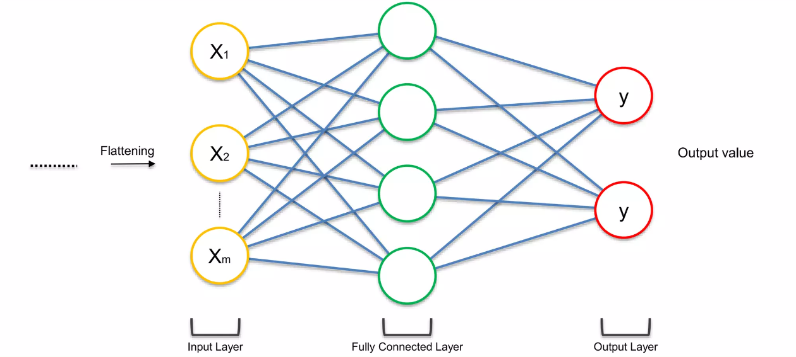
Step 4: Fully connected layer

Slide 3
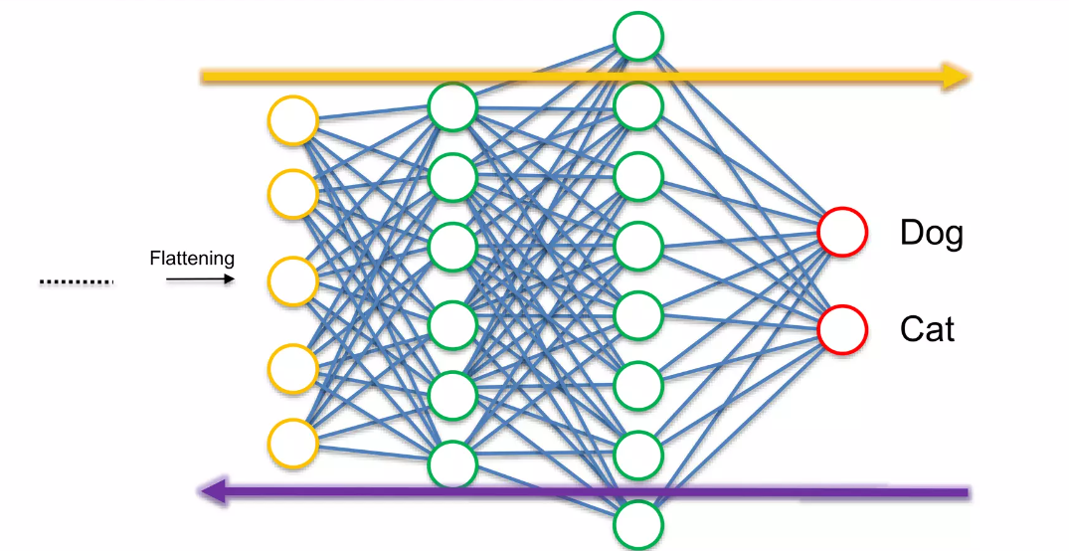
Fully connected layers
Pass a labeled image through the whole layer Starting the convolutional layer
Back propagate after the seeing the prediction

Slide 4
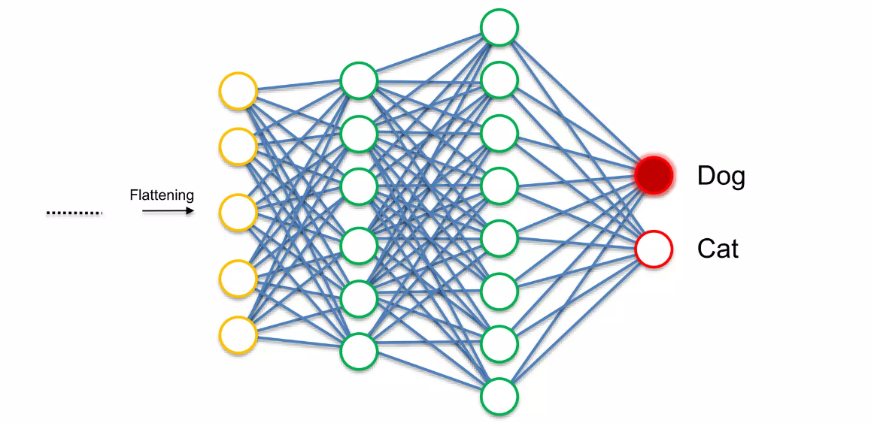
Fully connected layers

Slide 5
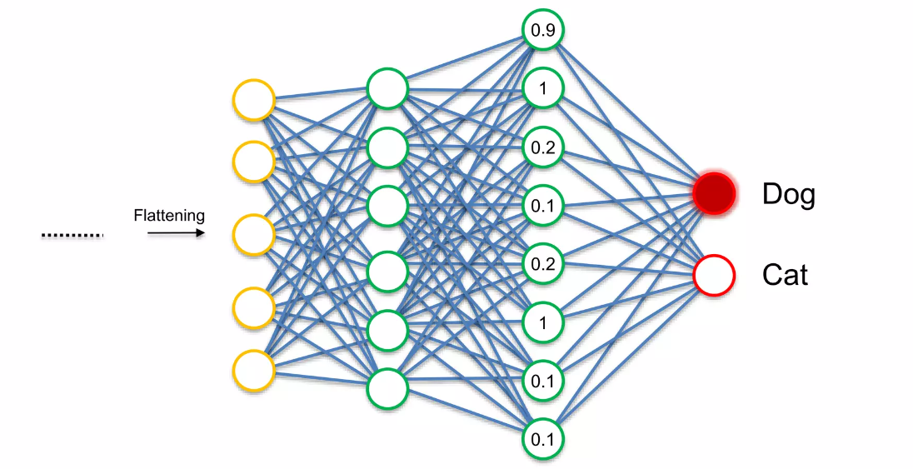
Training

Slide 6
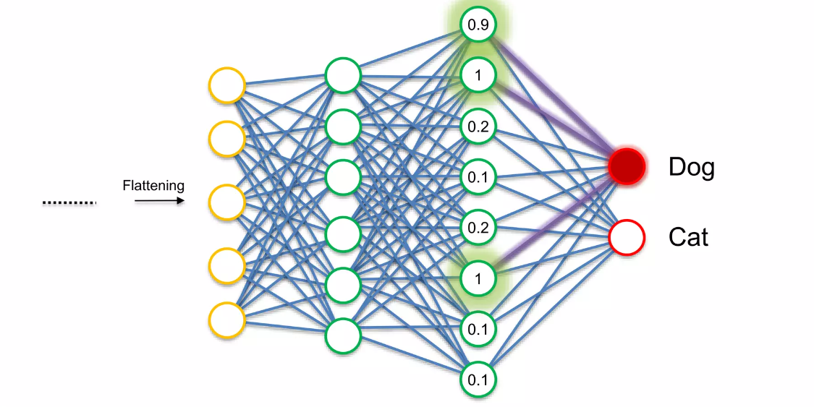
Training

Slide 7
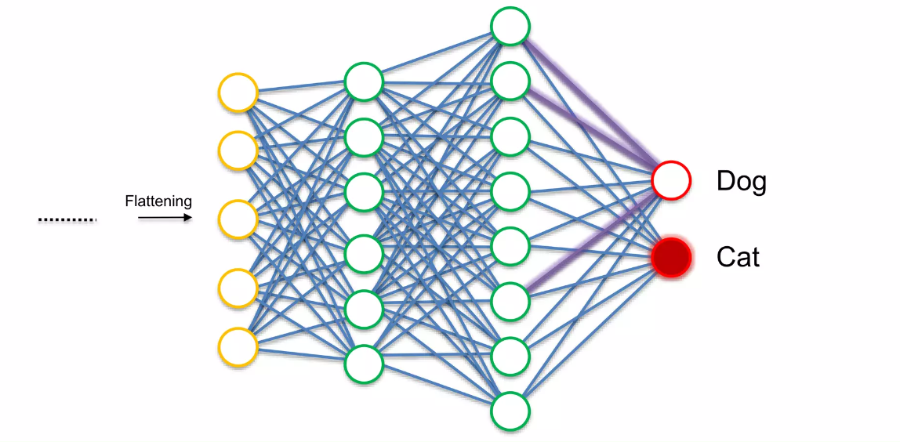
Training

Slide 8
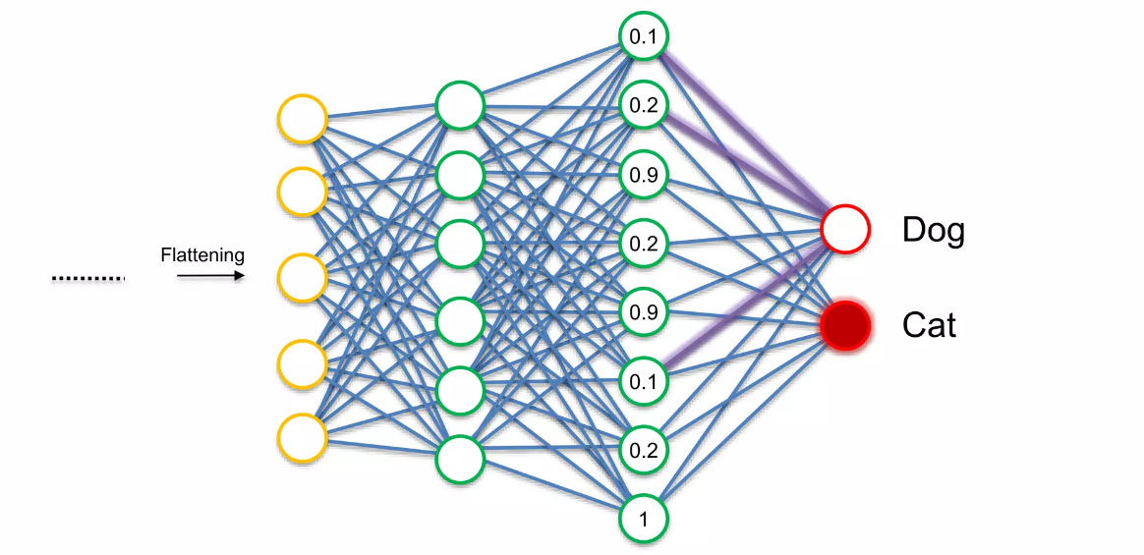
Training

Slide 9
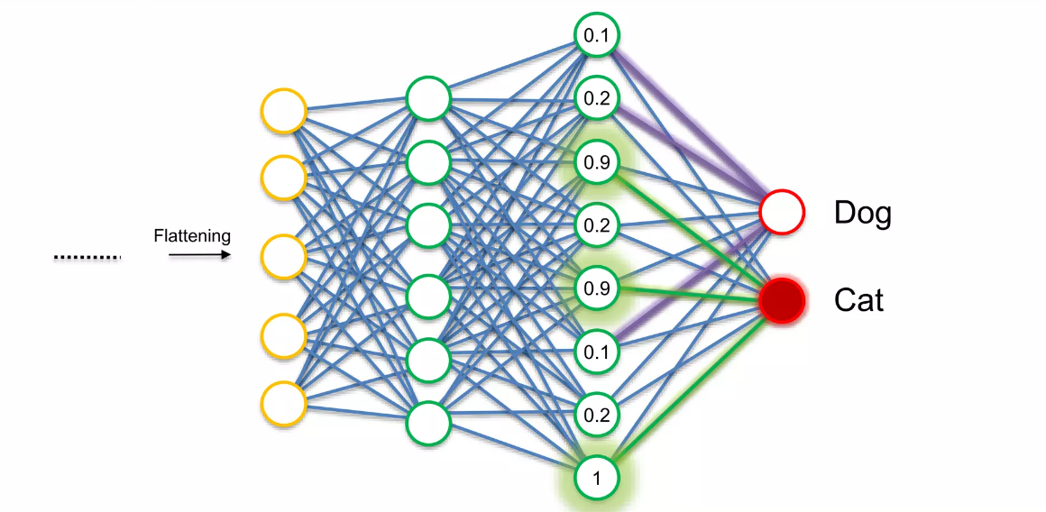
Training

Slide 10
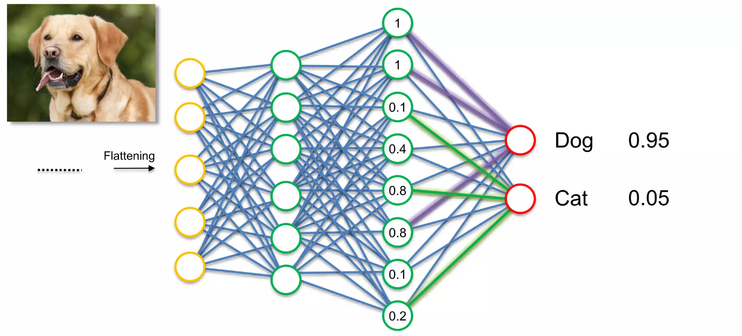
Inference

Slide 11
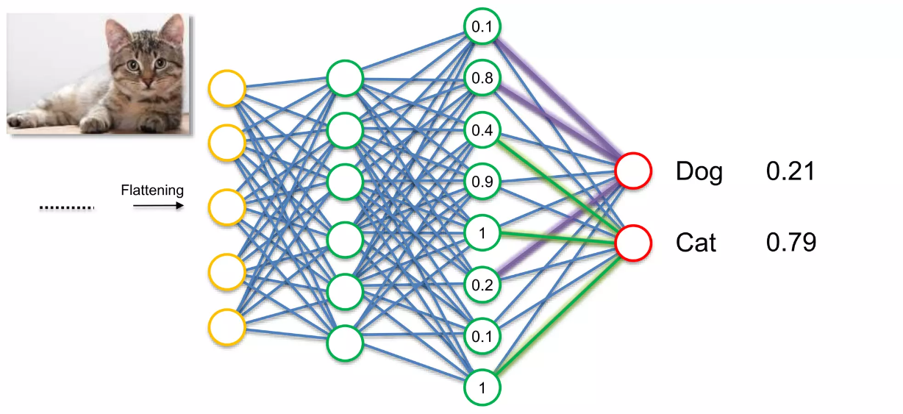
Inference

